Slide 1
TOOTH FAIRY
INTRODUCTION

Slide 2
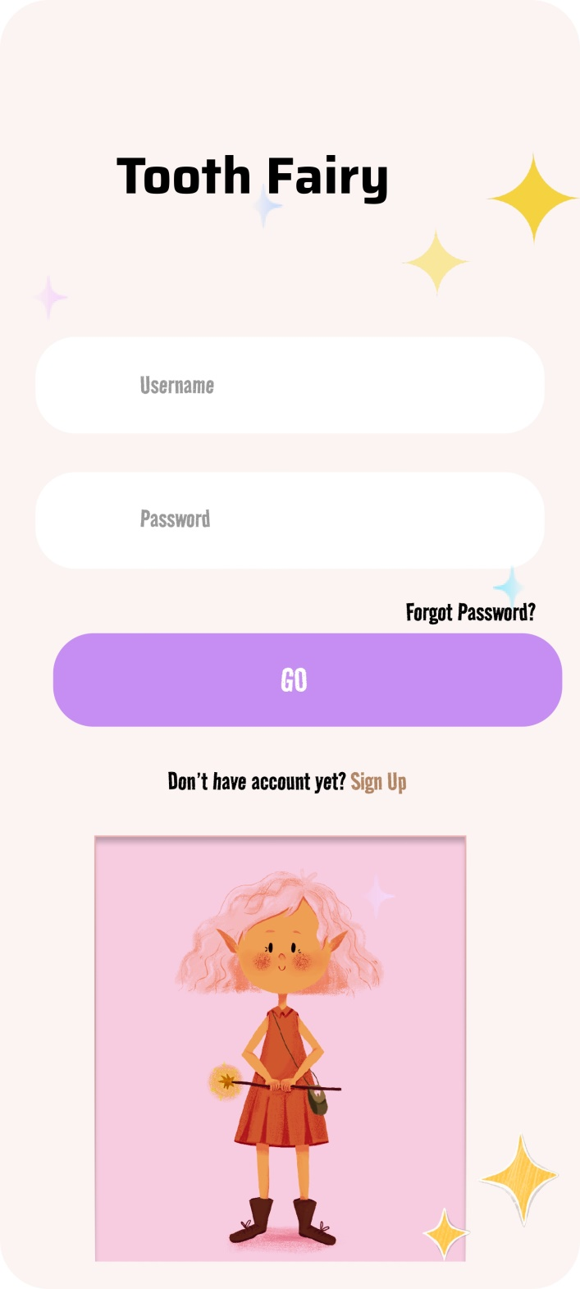
LOGIN PAGE

Slide 3
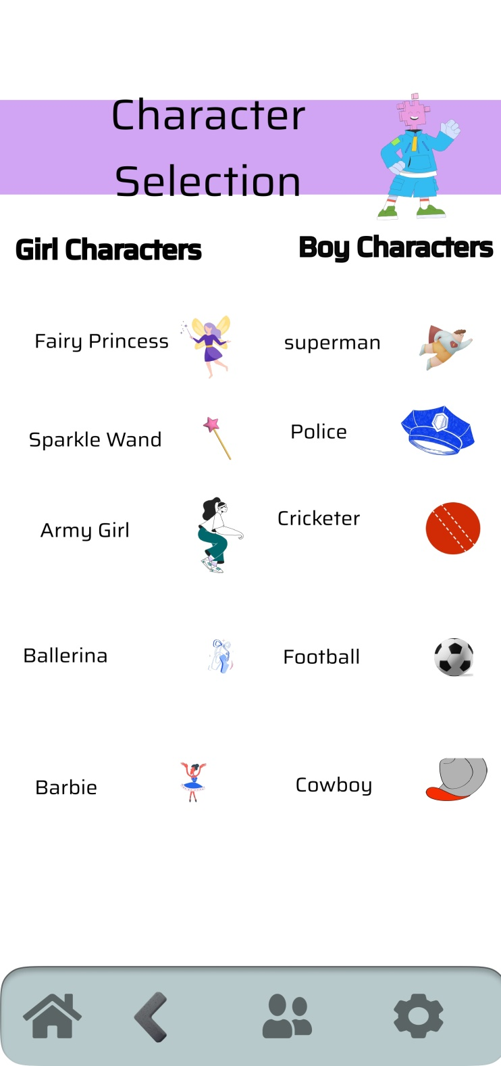

Slide 4
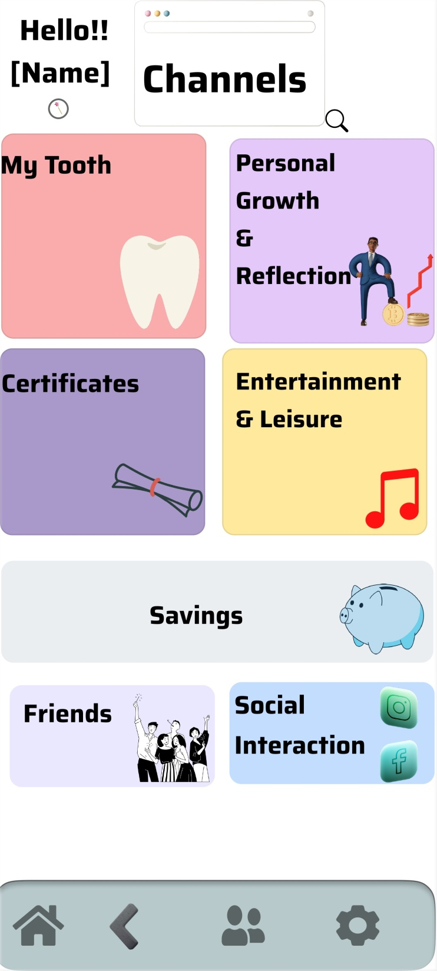

Slide 5
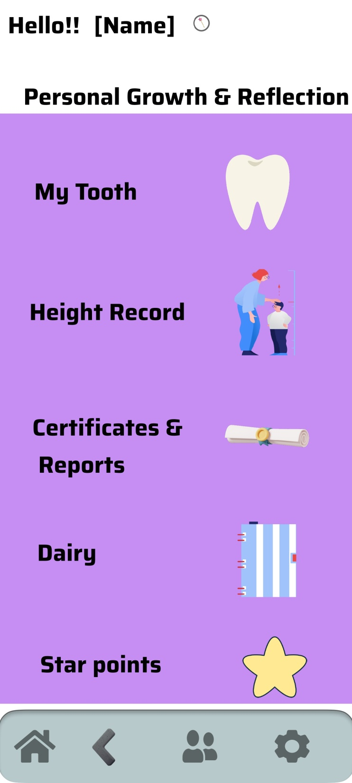

Slide 6
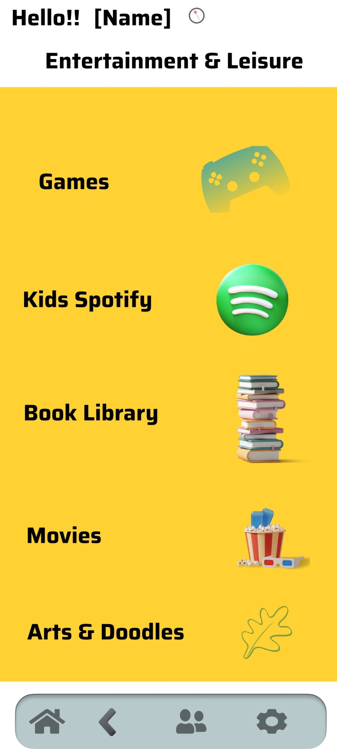

Slide 7
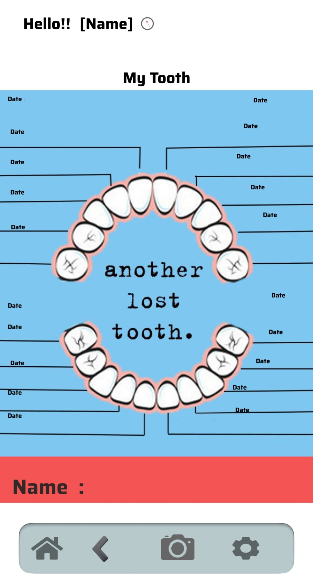

Slide 8
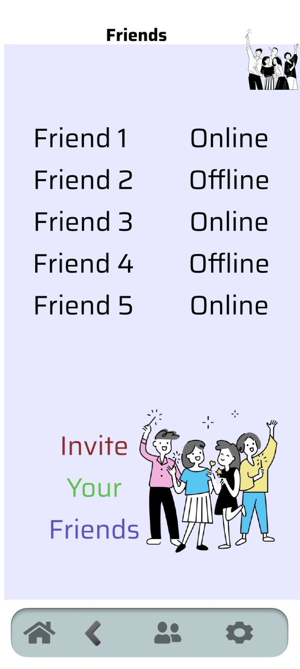

Slide 9
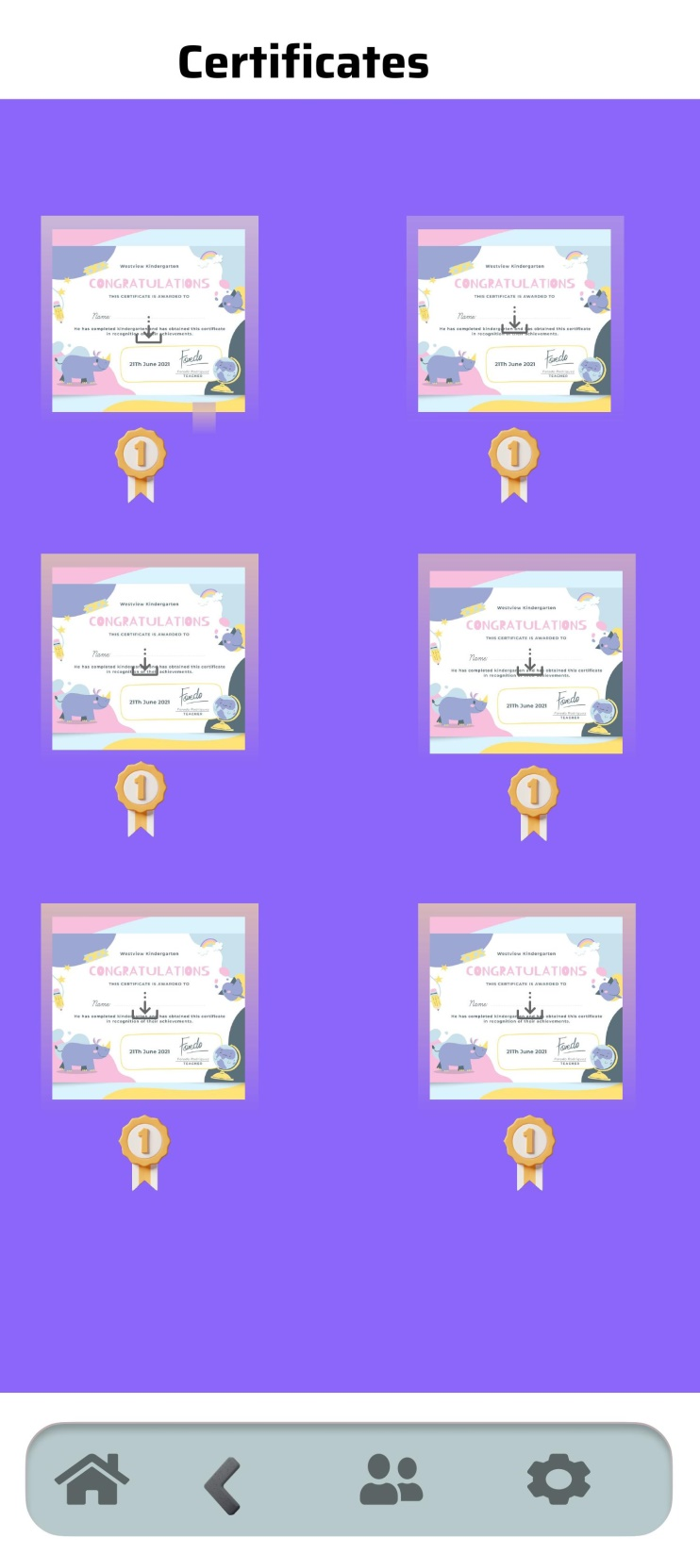

Slide 10


Slide 11
SUMMARY
The Tooth Fairy App is a digital platform designed by Johannes B. to engage children in the tooth-losing experience while providing educational and interactive features. Its purpose is to create an immersive and educational experience for children, incorporating elements of fantasy, creativity, and financial literacy.
Key stakeholders include children, parents/guardians, and the developer, Johannes B. The app offers various features, including an interactive website with customized themes, an AI-driven tooth photo analysis feature, a digital diary, height tracking, games, a virtual currency system, a book library, and financial literacy tools like compound interest simulation.
Functional requirements include features like tooth photo analysis, a digital diary, height tracking, games, virtual currency management, and parental consent for social interactions. Non-functional requirements encompass user experience, security, reliability, scalability, and accessibility.
The app's business goals are to enhance children's engagement with the tooth-losing experience, promote financial literacy, foster creativity, support charitable initiatives, and provide a safe digital environment.
In conclusion, the Tooth Fairy App combines fantasy, education, and entertainment to enrich children's experiences, instill valuable life skills, and promote social responsibility.

